Slide 1
Refining Transitions and Optimizing Collision Energy

Slide 2
Why “Refine” Transitions?
Spectral library data may be generated on a different mass analyzer
It is best to develop a method on the instrument where it will be acquired!
Optimizing transitions will provide the best quantitative results!

Slide 3
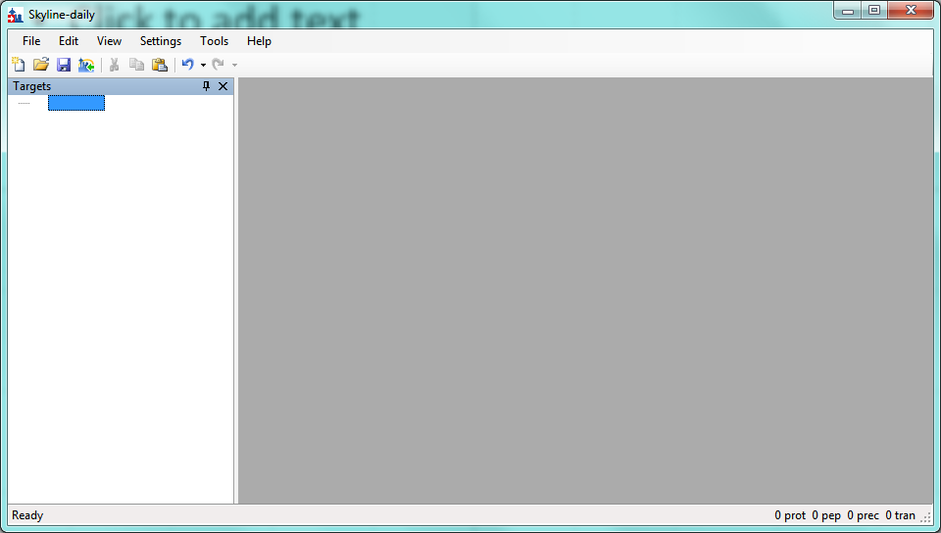
Start with Skyline

Slide 4
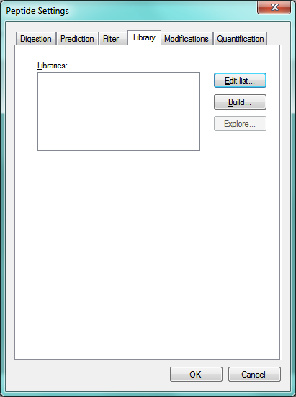
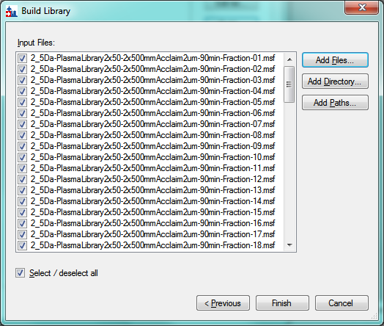
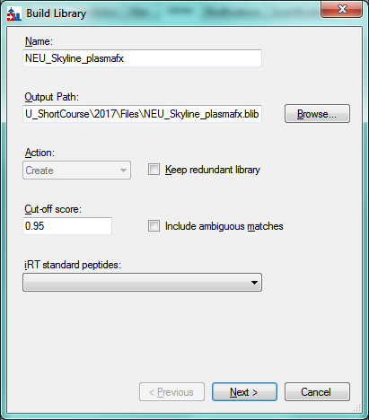
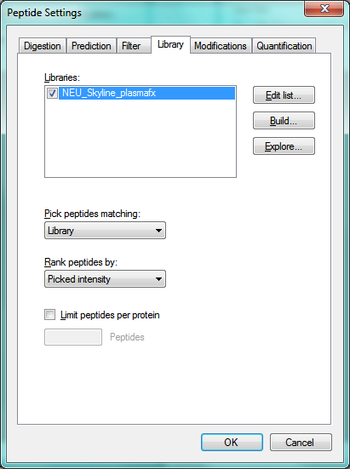
Generate a Spectral Library
1
3
2
4
Walk through library generation!

Slide 5
Add or Select Target Peptide Candidates
Picking precursors
Picking fragment ions (Discuss peptide fragmentation)
Fragment ion ratio pattern
RT correlation
Dot product
Selectivity
Interferences

Slide 6
Peptide Target Selection
All targets
Hypothesis-Driven
Set up peptide settings in Skyline
Import a .fasta file into Skyline
Insert a set of peptides into Skyline
Insert a set of transitions into Skyline
Refine, optimize, refine
Hands on Skyline walk-through

Slide 7
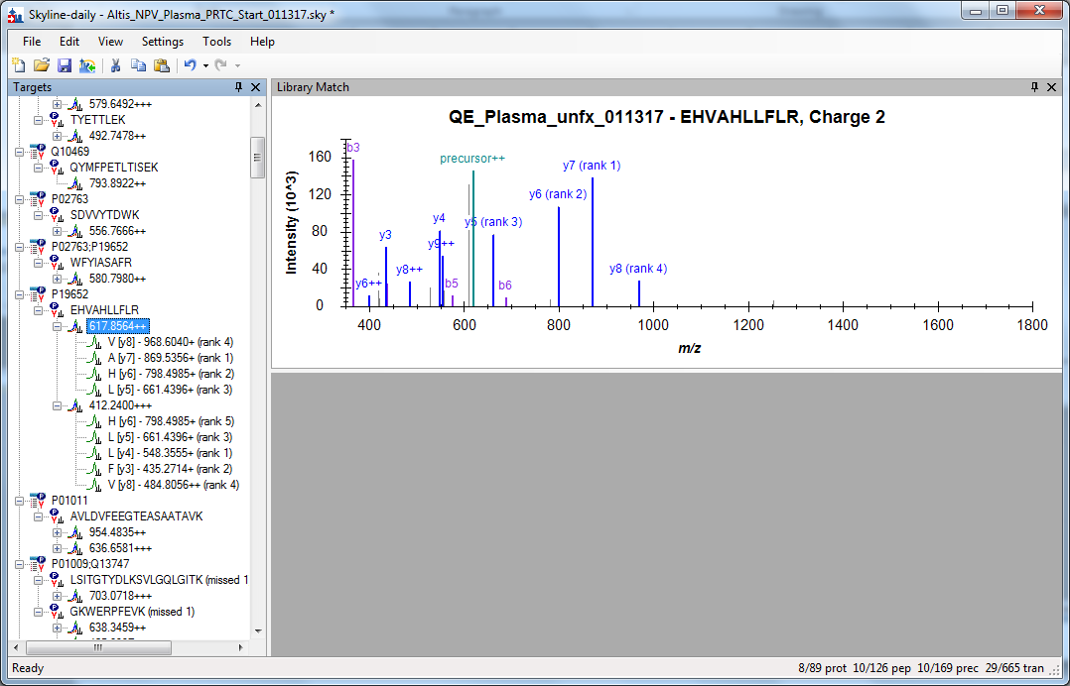
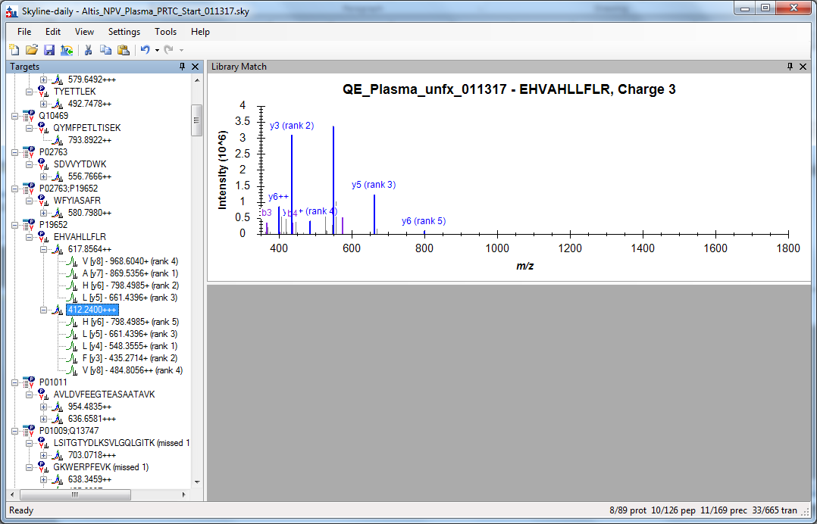
Some peptides may be detected in more than one charge state: Which charge state do you pick?
Sometimes it is best to just generate the data on the QqQ

Slide 8
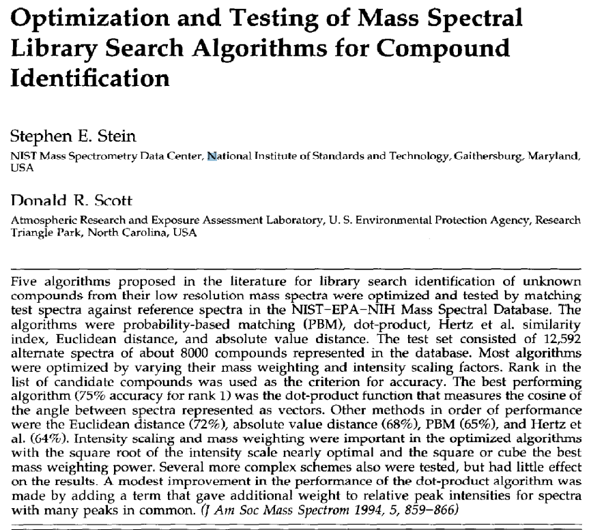
What is the dotp?
Dot Product!
Compares intensity and m/z of spectral libraries and data
Score range: 0-1
“Perfect” is 1.0

Slide 9
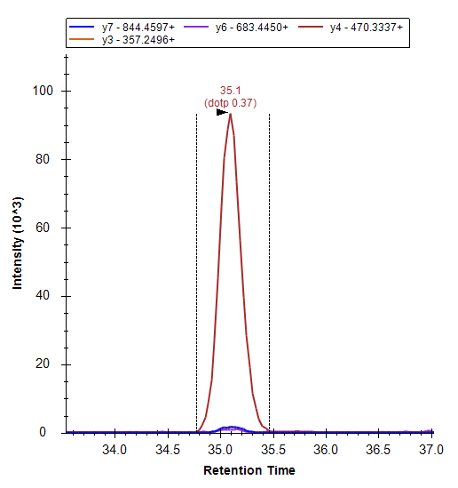
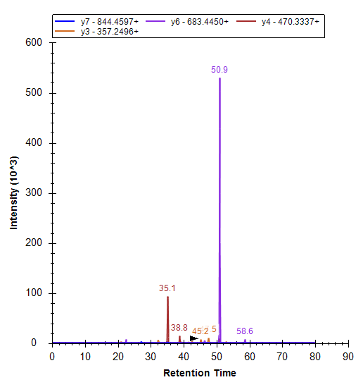
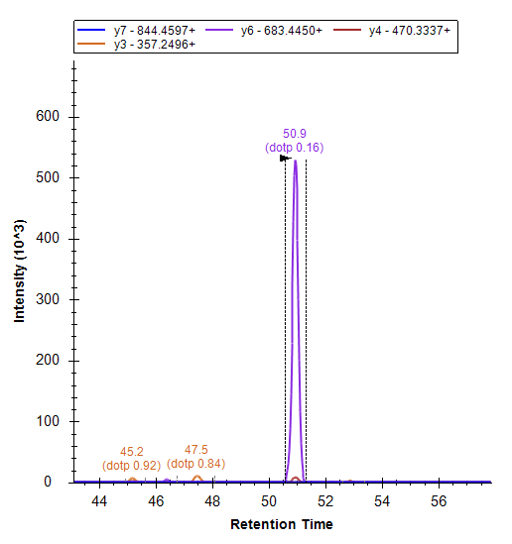
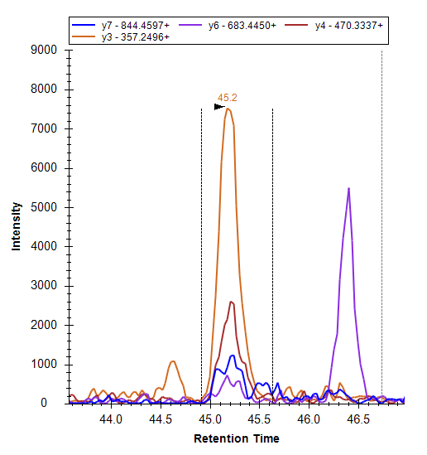
Look at the Dot Product (dotp)
Dataset: EXAMPLE_Carboxymethyl_NvsC…
K.FLEQECNVLPLK.L [106, 117]
dotp 0.92

Slide 10
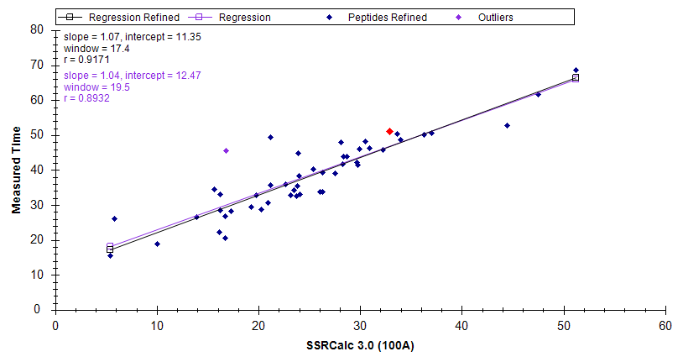
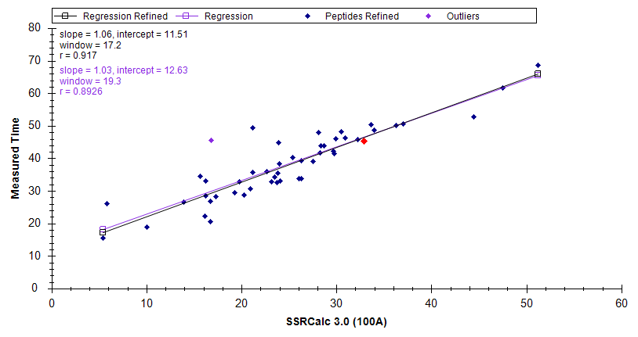
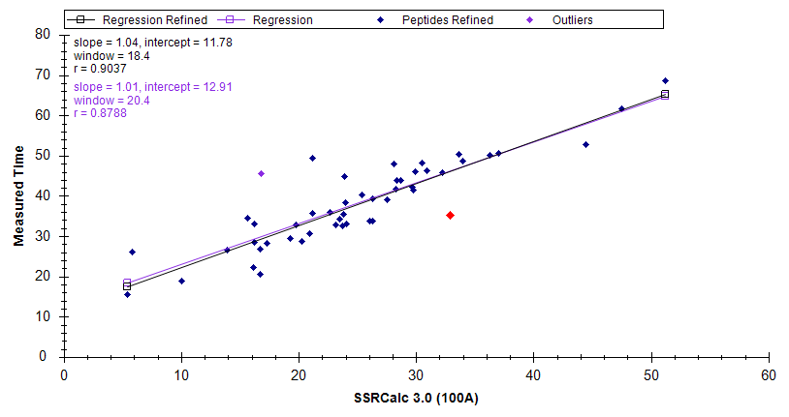
Look at the Retention Time Correlation and Use it as your Guide!
Dataset: EXAMPLE_Carboxymethyl_NvsC…
K.FLEQECNVLPLK.L [106, 117]
Peak @ 50.9 min
dotp = 0.16
Peak @ 42.5 min
dotp = 0.92
Peak @ 35.1 min
dotp = 0.37

Slide 11
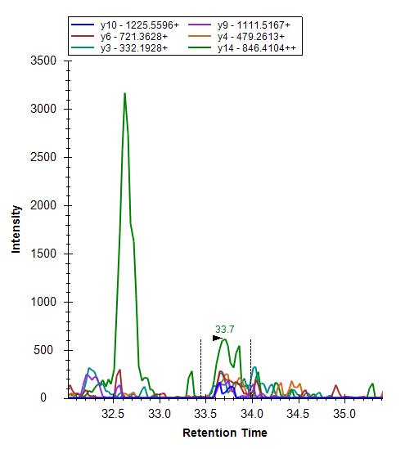
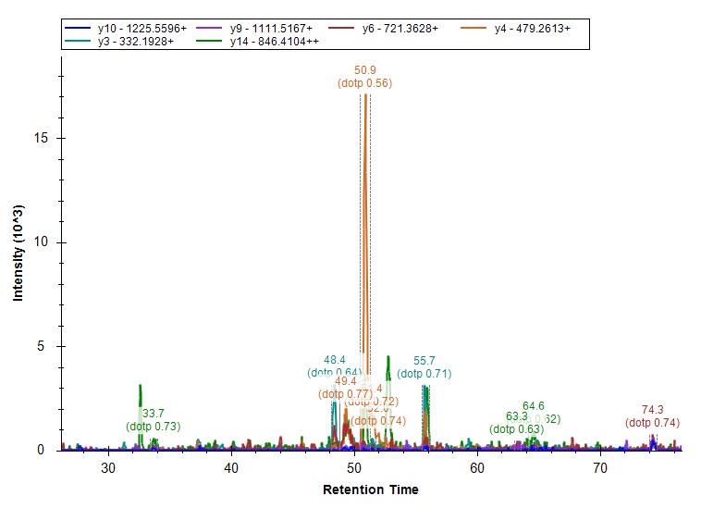
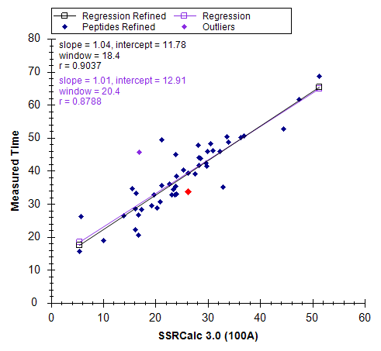
A More Difficult Example: Which is the Correct Peak?
Dataset: EXAMPLE_Carboxymethyl_NvsC…
K.VPLQQNFQDNQFQGK.W [35, 49]

Slide 12
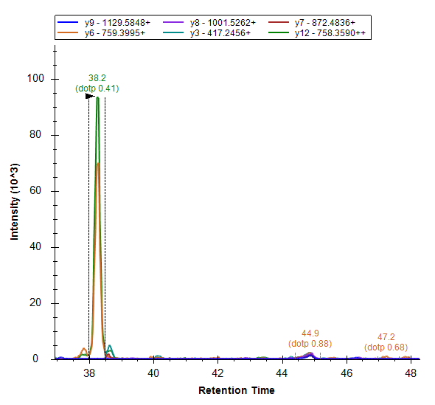
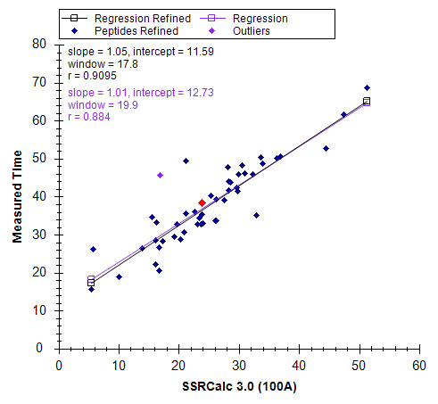
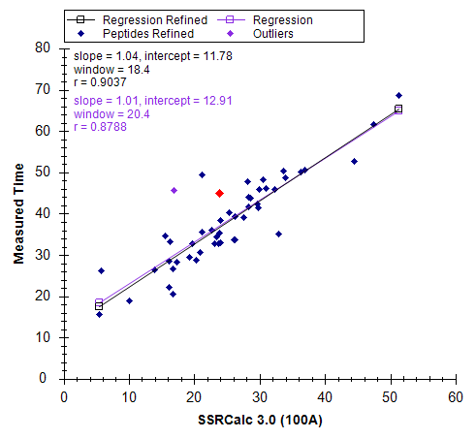
One Last Difficult Example
Dataset: EXAMPLE_Carboxymethyl_NvsC…
R.TPCQQELDQVLER.I [80, 92]

Slide 13
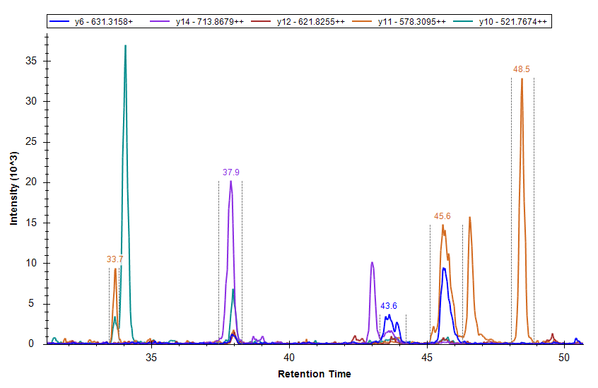
Now… Without dotp and Spectral Libraries
Dataset: EXAMPLE_Carboxymethyl_NvsC…
R.TSPSLSPQVNGTPSR.N [100, 114]

Slide 14
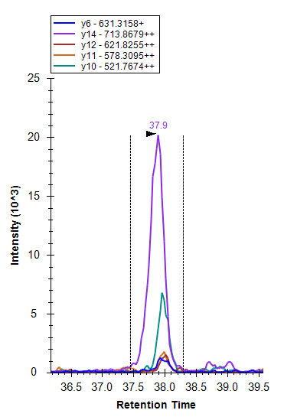
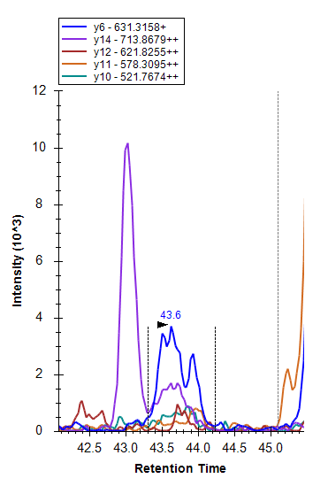
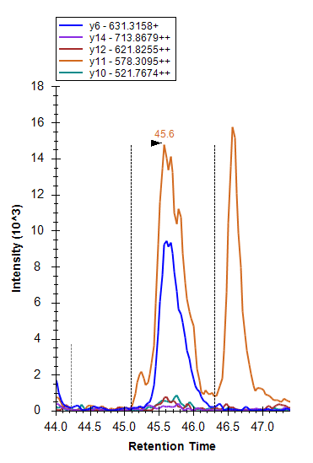


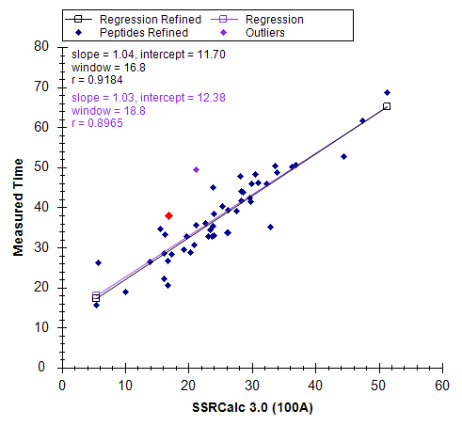


Our Options…
Dataset: EXAMPLE_Carboxymethyl_NvsC…

Slide 15
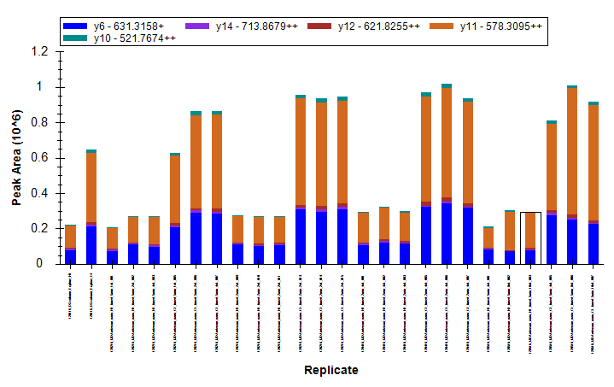
Why?
Dataset: EXAMPLE_Carboxymethyl_NvsC…
“Explore” files between “N” and “C” showed a difference in intensity for the same volume load for the 45.6 min peak.
All transitions were “symmetrical enough” and had the same apex (vs other peaks)
Comparing to other peptides from same protein, the fold-increase in intensity was similar

Slide 16
Tips & Tricks
Things to watch out for…

Slide 17
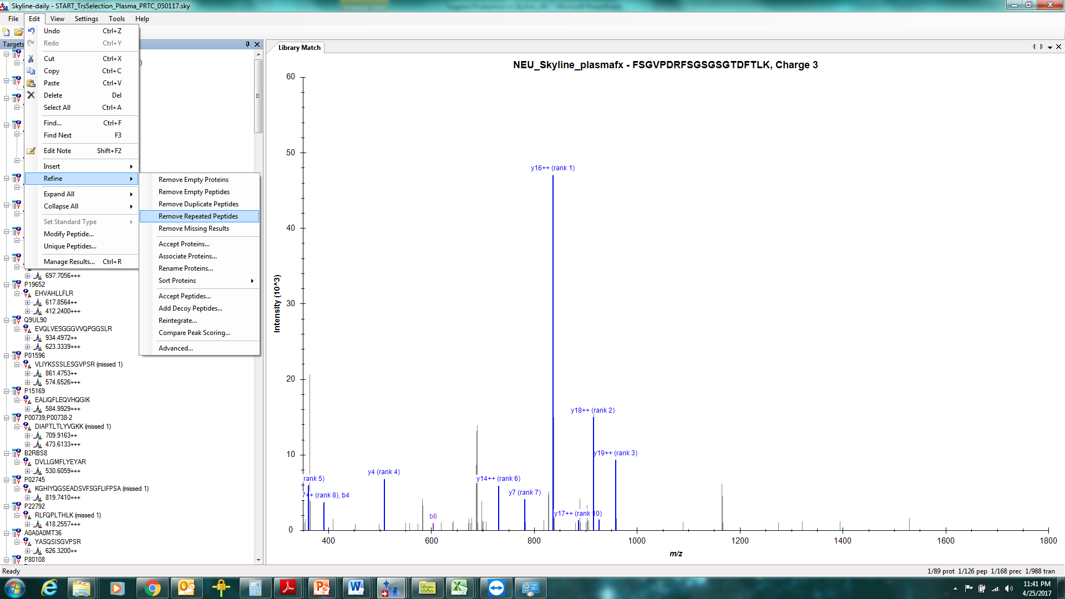
Duplicate and Repeated Peptides: Make sure that peptide is unique!

Slide 18
Interference Determination by Relative Ratios
090805_hASplus_250fmol_33
#
1925
RT:
23.52
AV:
1
NL:
3.92E5
F:
ITMS + c NSI Full ms2 566.12@35.00 [ 155.00-1100.00]
831.42
y8
100
W I N A T D P S A R
y-ions
90
80
b-ions
70
y4
60
50
430.26
40
557.07
y6
Relative Abundance
272.18
b2
y5
b6
30
646.36
300.11
b4
701.32
20
545.30
717.36
255.12
414.18
485.24
10
210.14
586.36
813.41
0
372.26
781.58
885.41
944.52
999.68
200
300
400
500
600
m/z
700
800
900
1000
1100
Fragment ions (*= heavy isotope standard ions) | y₄ | y₆ | y₈ |  | y₄* | y₆* | y₈*
Standard curve determination of fragment ion ratios | 2.1 | 1 | 3.85 |  | 2.1 | 1 | 3.85
MOLT-4 S, n =9 | 0.065 | 1 | 0.10 |  | 1.9 | 1 | 3.85
MOLT-4 R n = 9 | 0.64 | 1 | 1.16 |  | 1.98 | 1 | 3.98

Slide 19
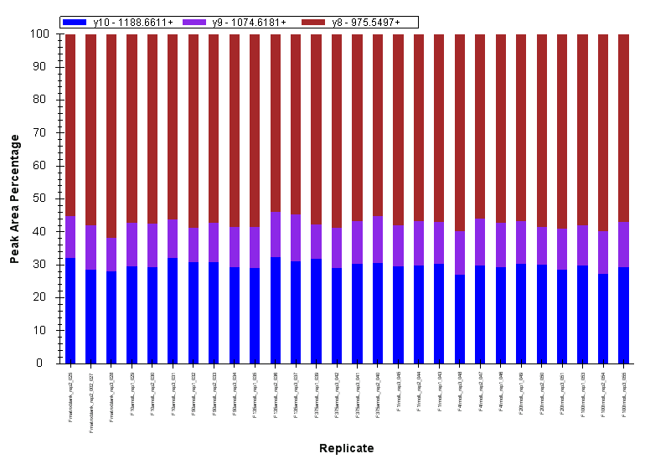
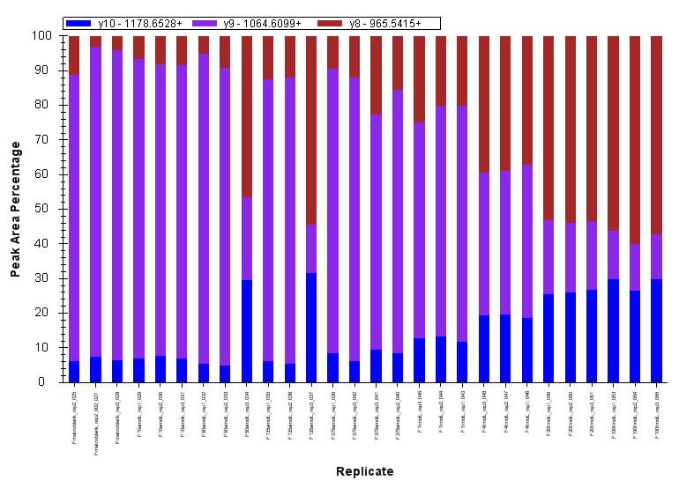
Interference Visualization
Heavy Peptide Transitions
Light Peptide Transitions
Notes:
When the view of the Peak Area plots is changed so that the signal is normalized to 100%, you can quickly observe for interferences.
Here, the heavy peptide has the same signal in all samples, the brown transition having the largest contribution to the overall signal.
When looking at the light peptide (low to high concentration left to right) in this data set, you can see the purple transition is too large, in comparison to the heavy peptide, and it decreases in size as the light peptide concentration increases. This is a quick way to visualize interferences in a response curve or any set of sample replicates.

Slide 20
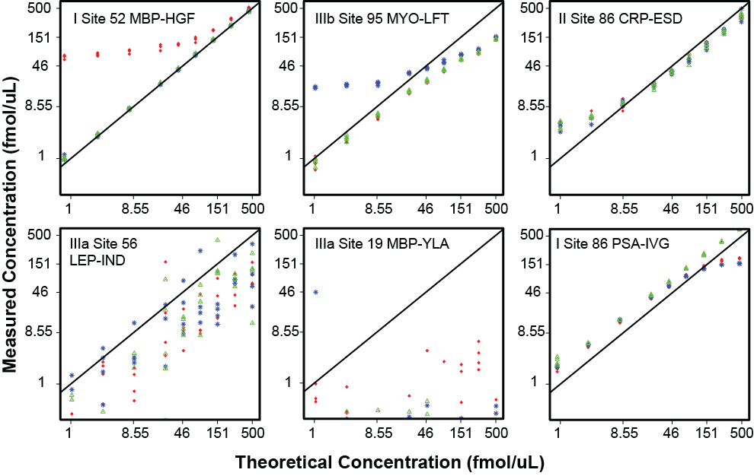
Identifying “Issues” in the Data
Interference in red transition
Interference in blue transition
Endogenous protein detected
interference
interference
endogenous
Peptide not
recovered
Detector sat’d at high conc.
MS unstable
not detected
unstable ESI
saturation
Addona, et al, 2009, Nat. Biotech

Slide 21
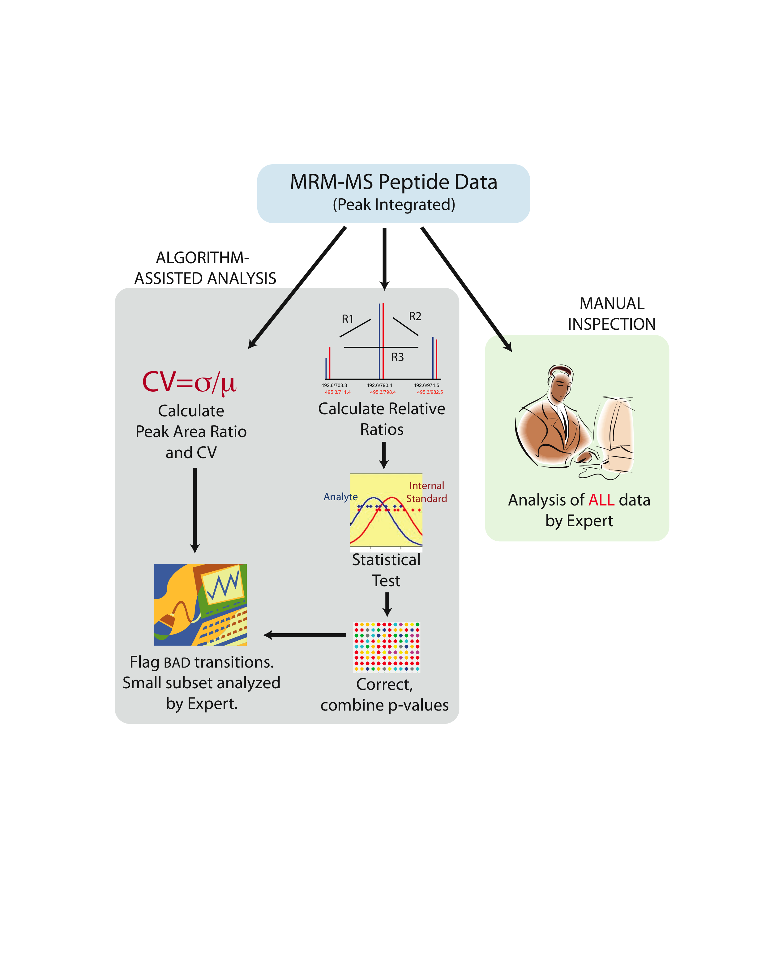
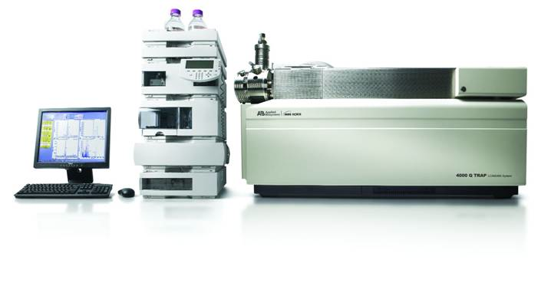
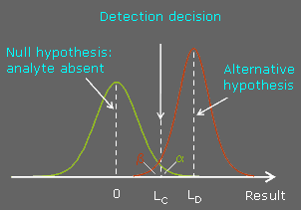


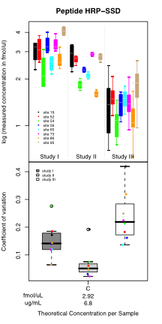
Data Processing in QuaSAR
AuDIT
LOD/LOQ
Pre-process & Filter
Concentration & sample info
Includes SISCAPA following antibody capture
Reproducibility
Cal. Curve & Regression
D. R. Mani

Slide 22
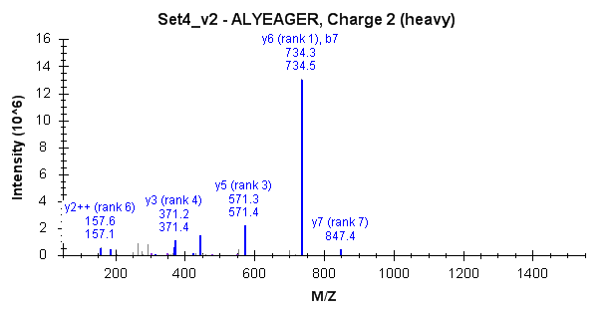
Problematic Transitions – Auto-interference (Intraference?)
Example:
ALYEAGER - R(+10)
Q1 m/z: 459.7314
y6 Q3 m/z: 734.3343 AND b7 Q3 m/z: 734.3355
RP= m/Δm
= 734.3343/(0.0012)
= 611,000 Resolving Power

Slide 23
Auto-interference Considerations
In light/heavy pairs, affects one peptide
The affected transition will have a different L:H ratio than the other transitions
Contributions from each fragment should be experimentally determined
We don’t want to throw out an intense y-ion because of a b²⁺ ion or other less likely fragment
Realistically, affects ~ 20% of peptides in Study 9
Theoretically, more peptides are affected (84/125 = 67%)

Slide 24
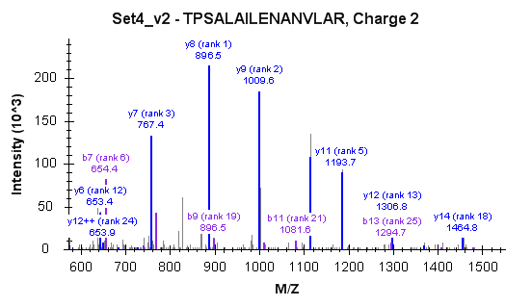
Bad peptide – y’s and b’s have large contributions

Slide 25
Experiment for auto-interference
L:H peptide ratio
1:20 | 1:1 | 20:1
No Matrix (so we can evaluate only self-interference)
Increase number of transitions to 4 where there is a problematic transition
Light/heavy synthetic peptides (3 samples, one at each L/H ratio above)
If self-interference is a problem, then the L:H ratio should differ from theoretical

Slide 26
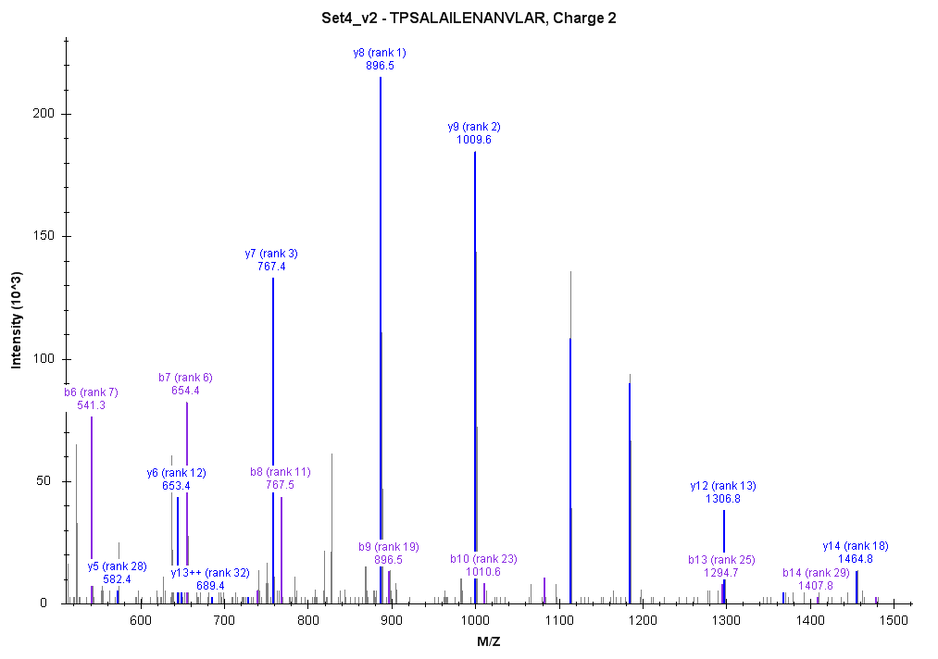
Example of data with auto-interference in heavy peptide
1:1 ratio for product ions (L:H = 1.0)
y7 = 0.75 (25% interference from b8)
y8 = 0.9 (10% interference from b9)
y10 = 1.0 (no interference)
y11 = 1.0 (no interference)
1:20 ratio for product ions (L:H = 0.05)
y7 = 0.038(25% interference from b8)
y8 = 0.045 (10% interference from b9)
y10 = 0.05 (no interference)
y11 = 0.05 (no interference)
20:1 ratio for product ions (L:H = 20)
y7 = 15 (25% interference from b8)
y8 = 18 (10% interference from b9)
y10 = 20.0 (no interference)
y11 = 20.0 (no interference)

Slide 27
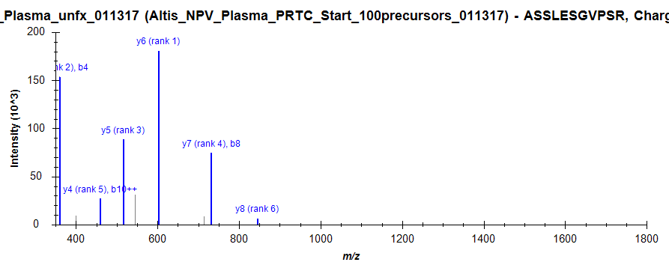
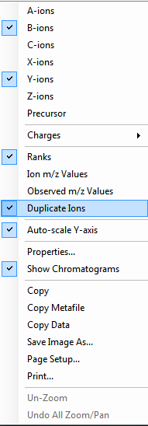
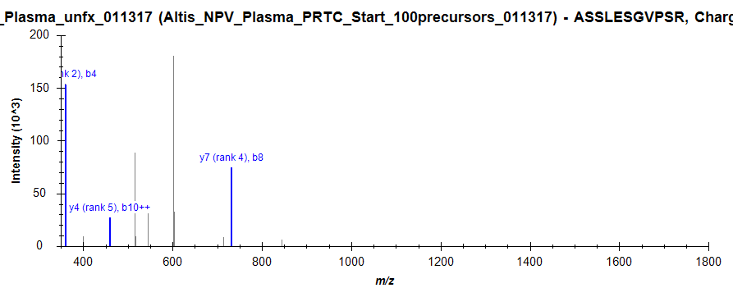
Duplicate Ions Feature in Skyline!

Slide 28
Optimizing Collision Energy
Do I need to?
What are the trade-offs?

Slide 29
On a Triple Quadrupole
Each product ion is generated sequentially
So each product ion can be optimized individually
Selected Reaction Monitoring (SRM)
Gas for CID

Slide 30
Collision Energy Optimization
Conducted to determine the energy that will produce the largest intensity from each product ion from the CID event
Vary CE and monitor MS intensity
Usually done by sample infusion with syringe pump
Efficiently done on-line with LC using Skyline
Correlations can be modeled on optimal CE vs m/z and z
CE (V)

Slide 31
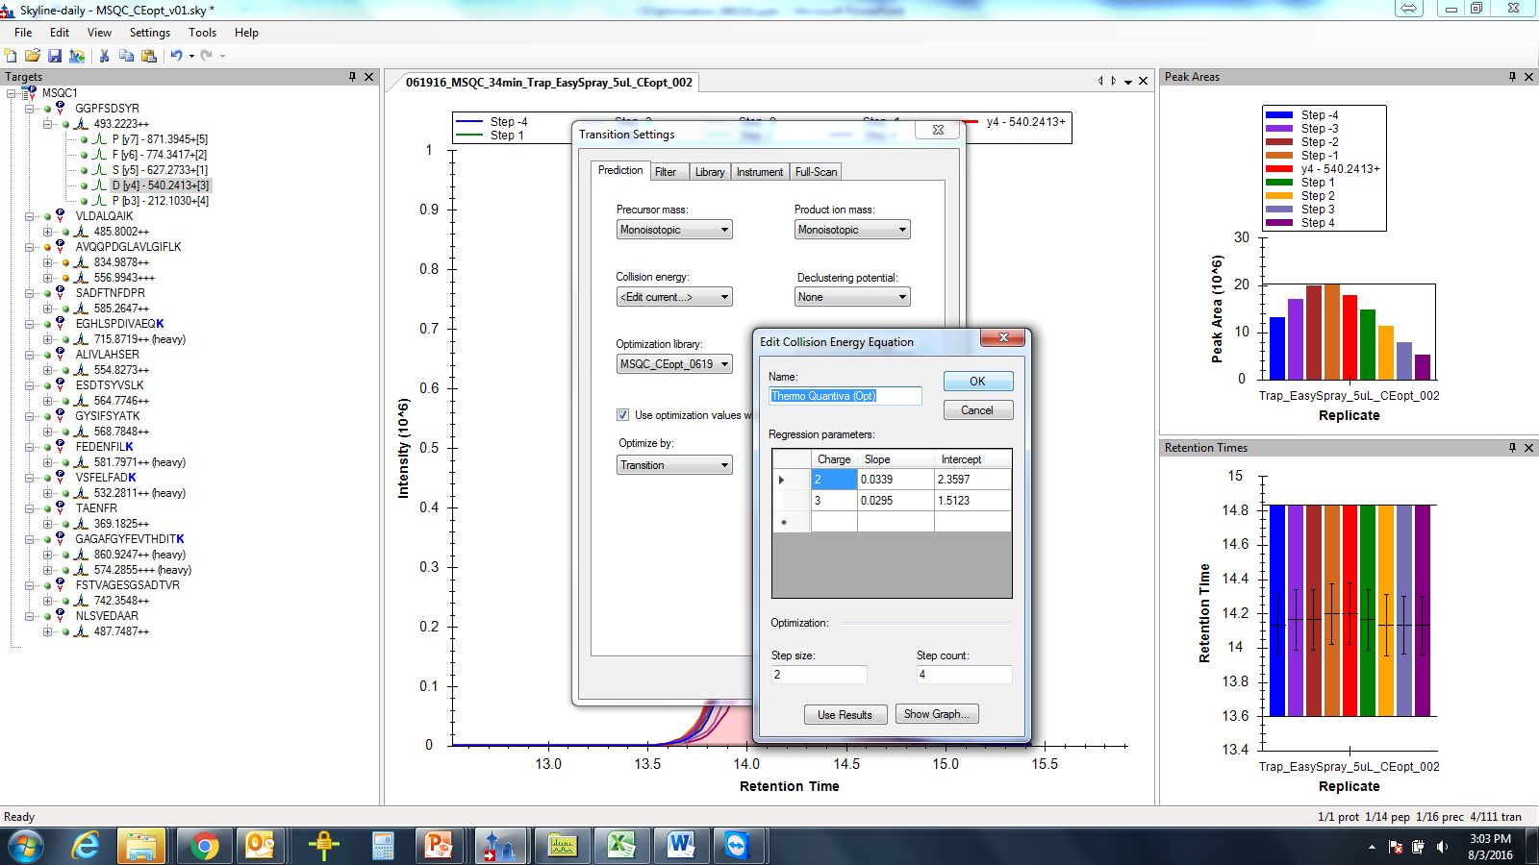
Options in Skyline for on-line CE optimization

Slide 32
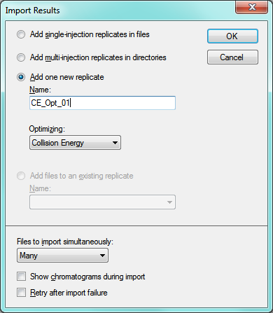
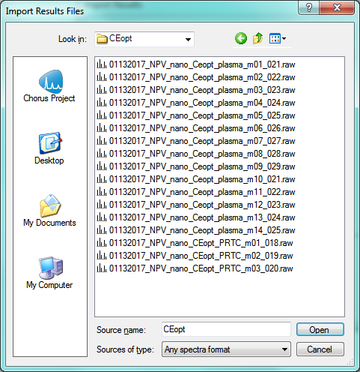
Importing Results

Slide 33
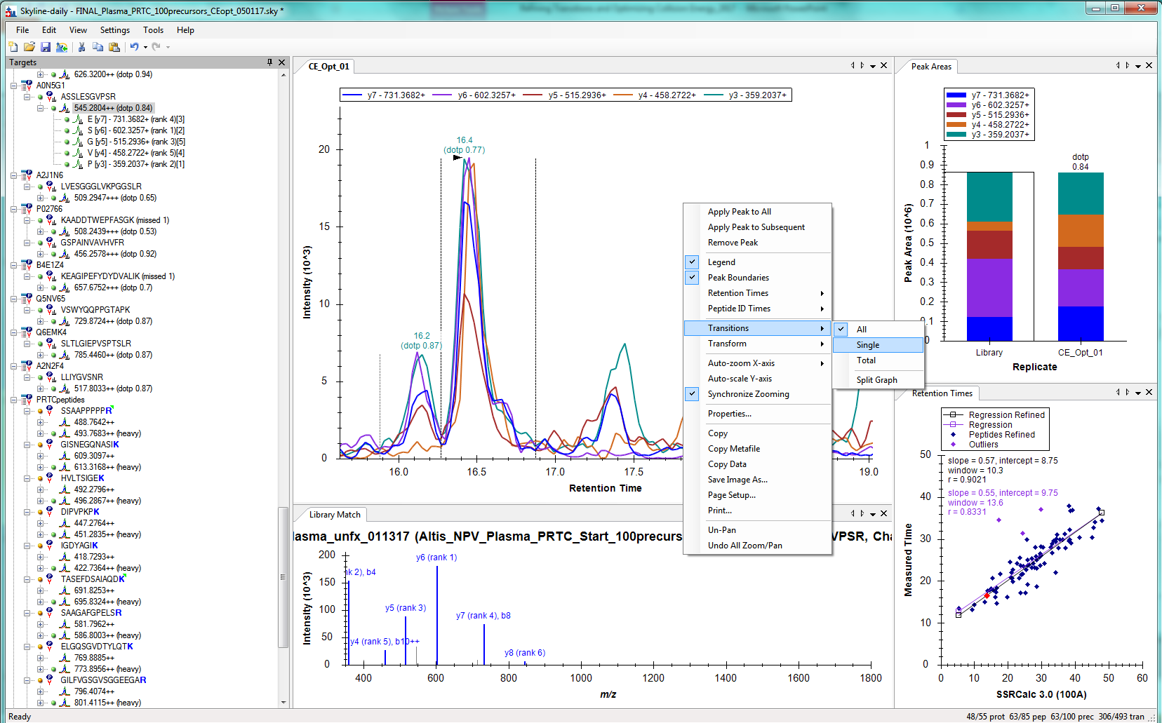
Change Transitions to “Single” for viewing CE optimization data

Slide 34

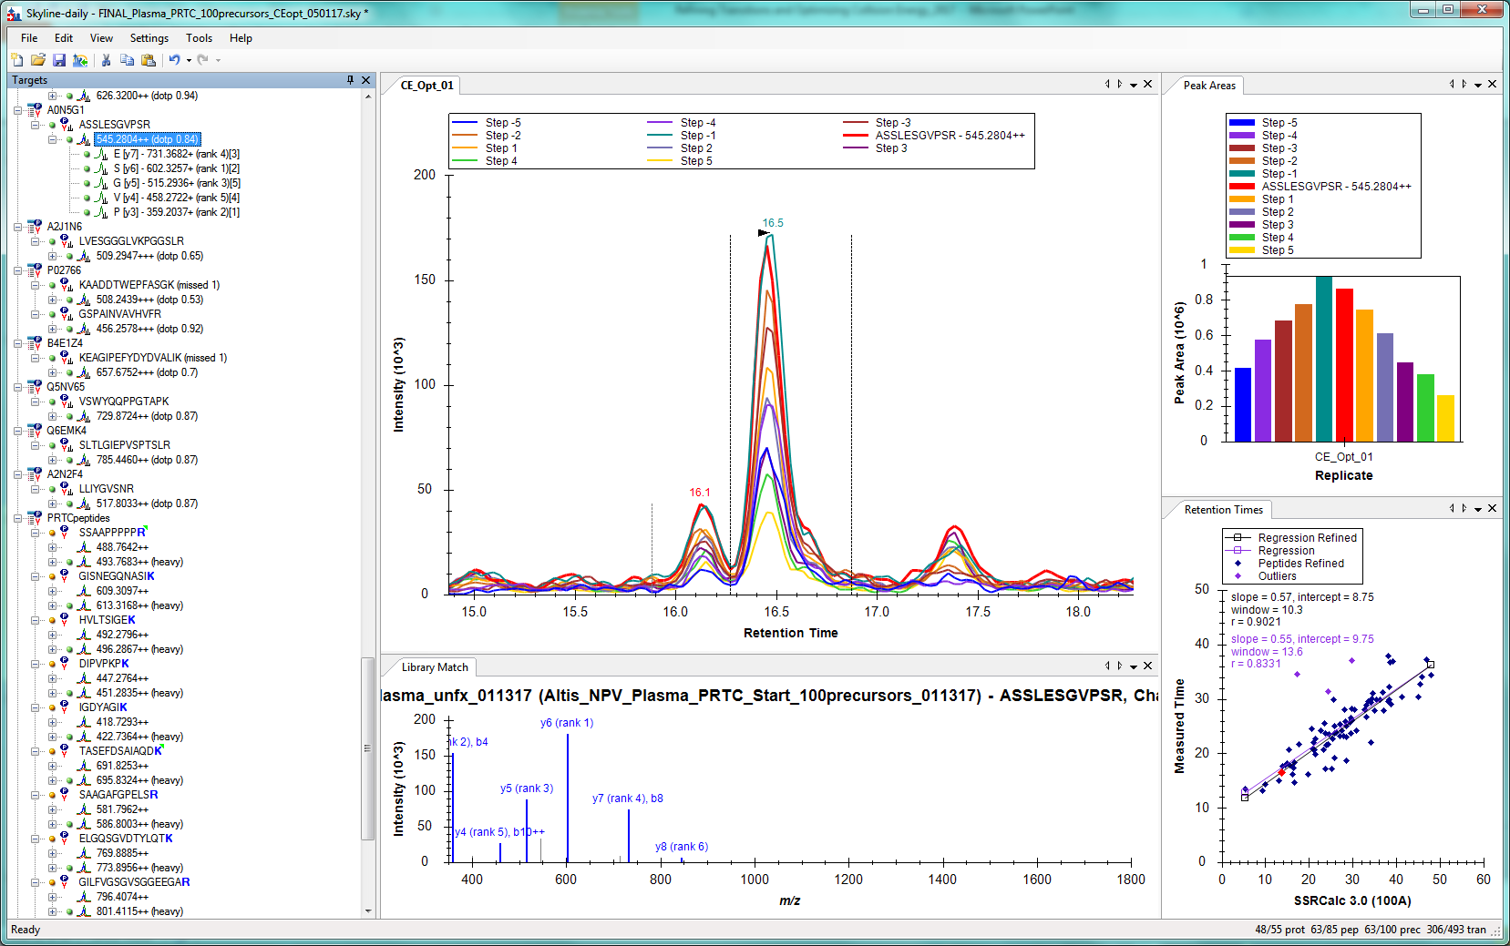
Each color is a different CE voltage!

Slide 35
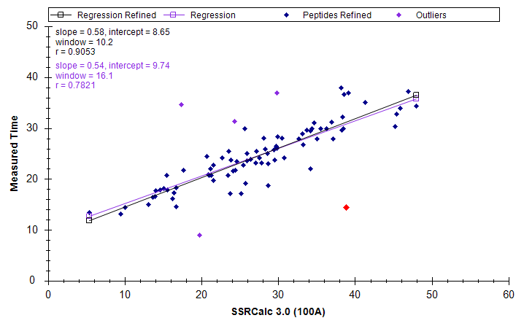
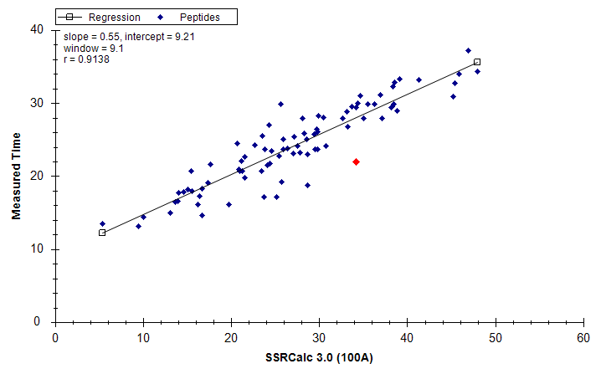
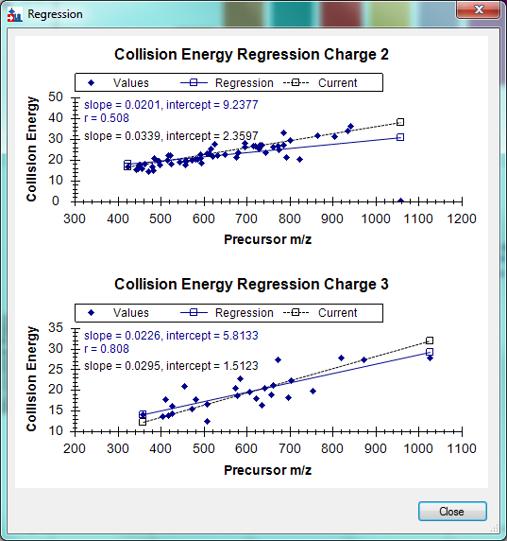
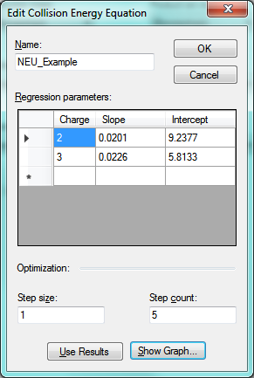
Check your Data before Proceeding!
Fix RT outliers
After
Before
“Use Results” to generate CE regression equations

Slide 36
How far off are we?
Throwing off regression a bit…
 | m/z | CE
Before | 500 | 19.3097
After | 500 | 19.2877
Before | 500 | 16.2623
After | 500 | 19.1133
2+
3+
3+ precursors sometimes have issues…

Slide 37

Weird Cases: +3 precursor and +2 product

Slide 38

Similar on Agilent 6460: Before Refining Equations

Slide 39

Precursor Level Optimization Looks at total signal from all products at each CE

Slide 40

Product Level Optimization Looks at individual signal from each product at each CE

Slide 41

What Does CE Optimization Buy You?

Slide 42









If you have good equations, do you need to optimize?

Slide 43

Last word: Don’t forget about PTMs!
During CID, energy can rearrange and “pop off” PTMs such as phospho or glyco groups (neutral loss)
Resulting product ion may be the un-modified peptide, intact
Peptide sequence information may be lost
Site of modification may be lost
HCD (higher energy collisional dissociation) is known to have this drawback (used on QqQs)
Lower energy dissociation (like ECD, ETD) help here!
http://www.inf.fu-berlin.de/lehre/WS14/ProteomicsWS14/LUS/lu7a/483/objects/il_1600_mob_1124807/collision_chamber.png

Slide 44

Summary
Transition selection and optimization are important
Balance the sensitivity gains you NEED with the efforts to acquire them!
Always worry about interferences!
There is nothing wrong with manually looking at your data
Just know when to stop and trust the software

Slide 45

Questions?

